Slide 1
0x10A – Networking & Communications
ECED4406 – Computer Security
Dr. Colin O’Flynn
Dalhousie University.

Slide 2
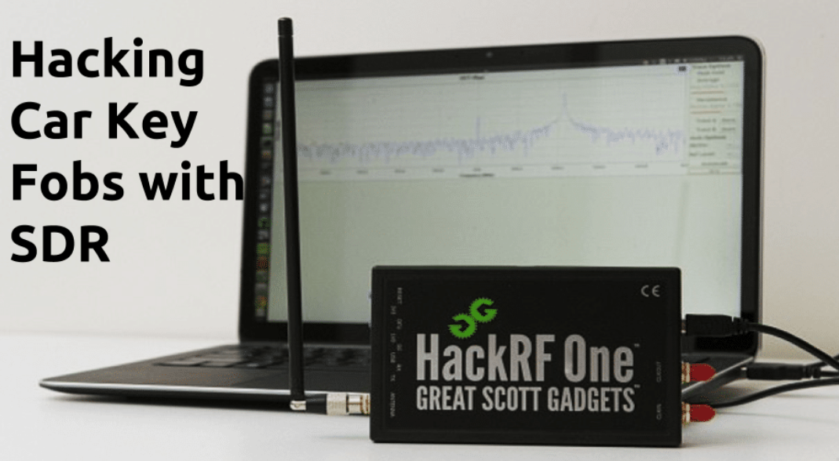
Part #1 - Wireless Hacking
https://www.lufsec.com/hacking-car-key-fobs-with-sdr/

Slide 3
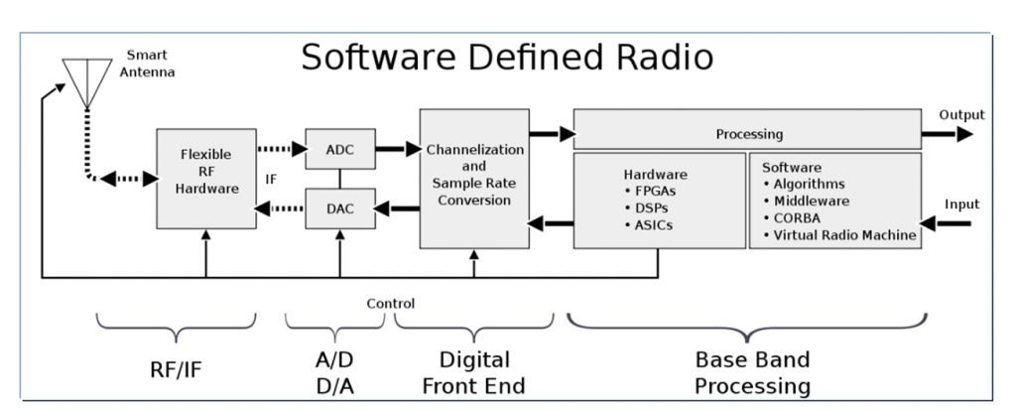
Software Defined Radio
Highly flexible radio receiver/transmitter system.

Slide 4
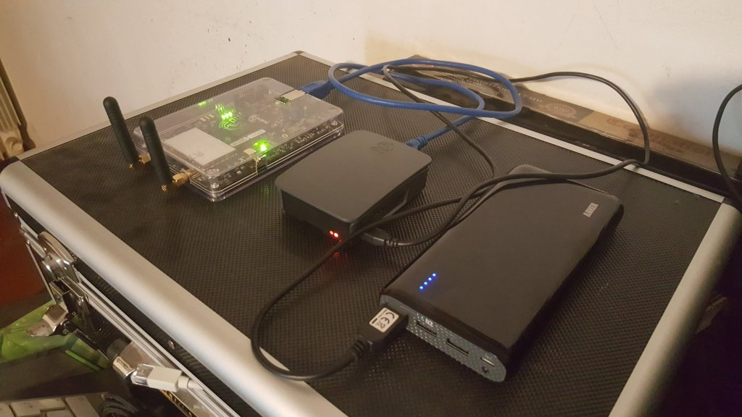
SDR Attacks
SDR allows talking to non-standard devices (or devices where no usual protocol).
https://www.evilsocket.net/2016/03/31/how-to-build-your-own-rogue-gsm-bts-for-fun-and-profit/

Slide 5
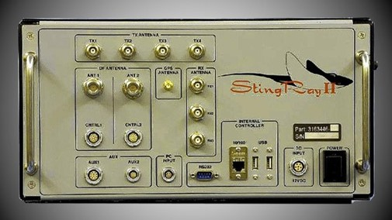
GSM Basestation / Cell Phone Attacks
Police have had a device known as ‘StingRay’ for some time.
Can either create a fake base-station, or track users/direction, etc.

Slide 6
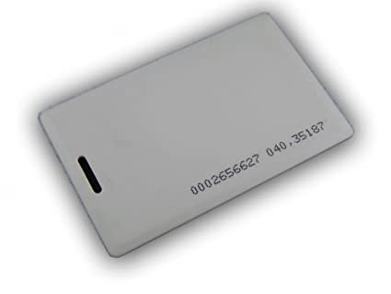
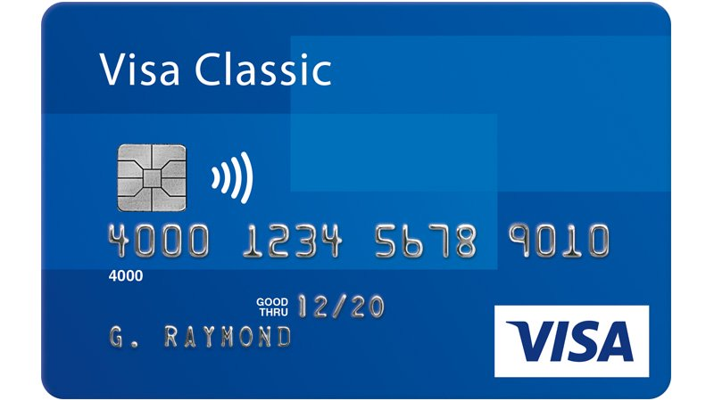
RFID Cards
Radio Frequency ID (RFID) tags are used for all sorts of purpose – probably you use them in your credit card, access control, etc.

Slide 7
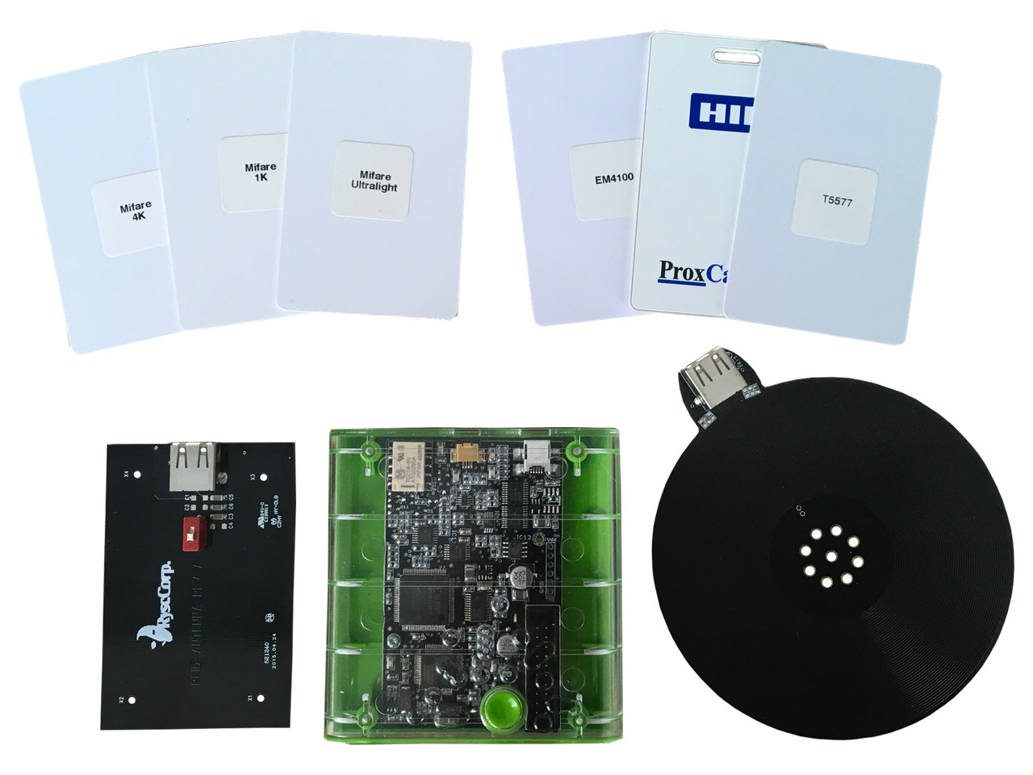
RFID Attacks (Proxmark 3 Example)
https://blog.kchung.co/rfid-hacking-with-the-proxmark-3/

Slide 8
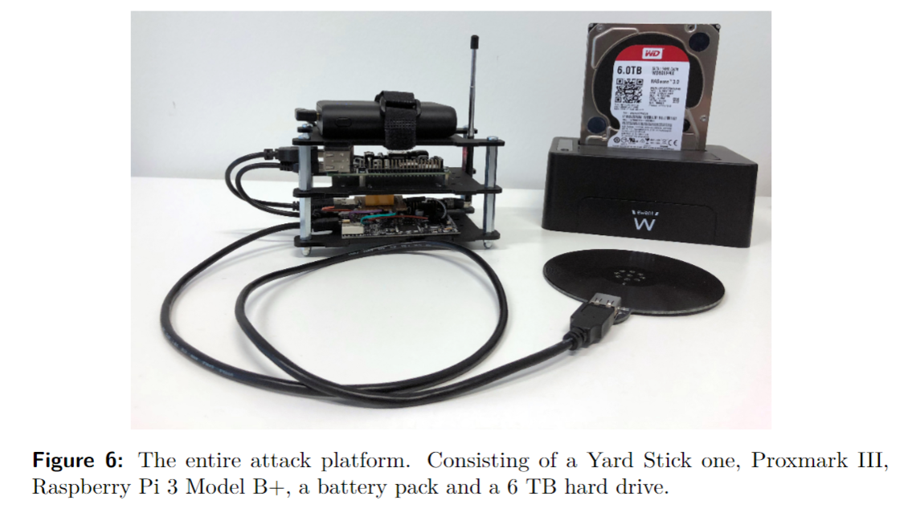
Example: Tesla Keyfob Cloning
Example of a real attack that is not just a simple clone attack.
Required finding flaws in the cryptographic protocol used, but ultimately able to perform a ‘real life’ attack to clone a keyfob (and steal a car).
https://tches.iacr.org/index.php/TCHES/article/view/8289

Slide 9
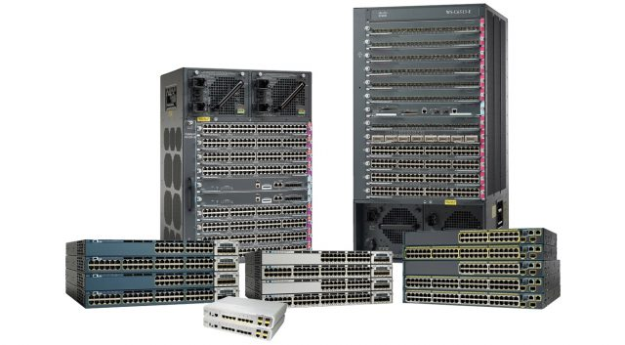
Part #2 - Attacking Network Equipment
Example: Cisco routers are found in almost all networks.
They are effectively computers… thus attackable.
Example: https://thrangrycat.com
Possible to rewrite firmware on huge range of servers.

Slide 10
Networking & Communications
This area starts to very quickly overlap with regular cyber-security work.
Wireless & SDR hacking is itself a large subfield.
RFID hacking also a large subfield too.

